Slide 1
Guided Clustering Tutorial
Mentor:Dr.Zhang
Adithya Ayanam - CTSI STEM Intern

Slide 2
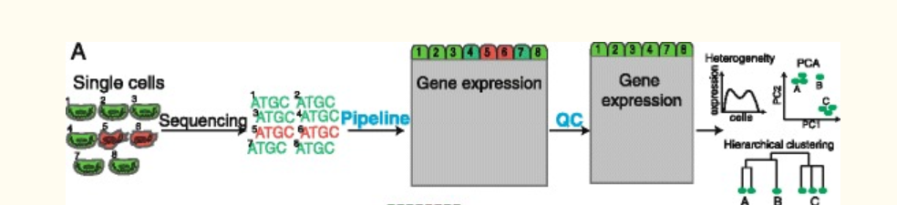
Step A: RNA -Seq Workflow
Green indicates high and red low quality cell

Slide 3
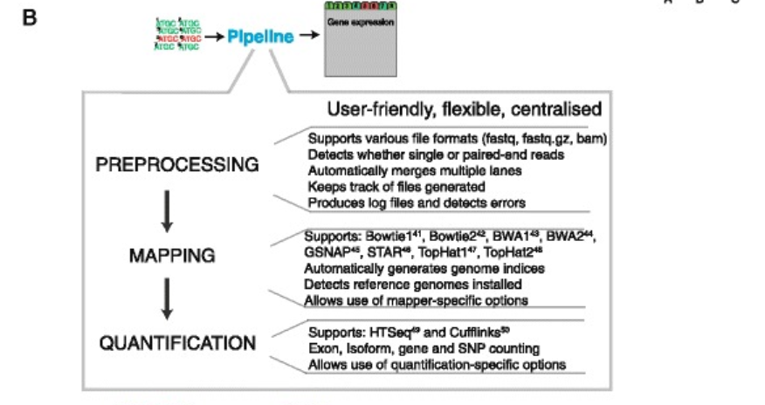
Step B:Computational Pipeline to Read the RNA -Seq data

Slide 4
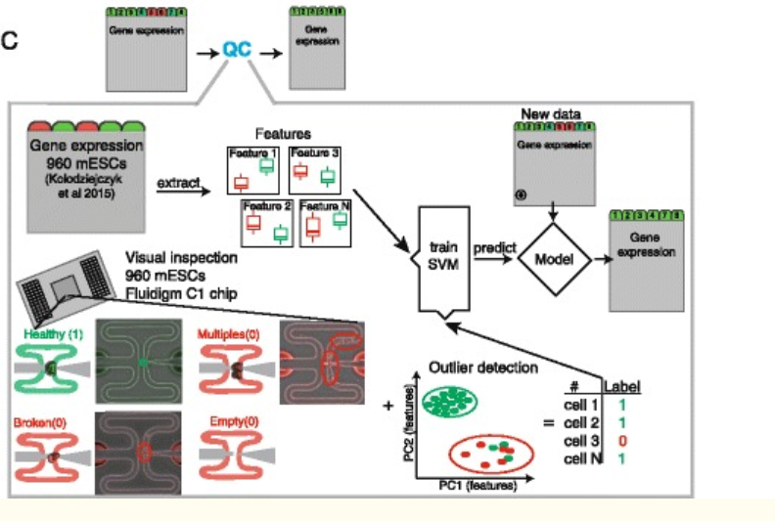

Slide 5
Raw Data
Analyze the dataset of Pheripheral Blood Mononuclear Cells(PBMC)
Download the raw data from here.
The Read10X function reads in the output of the cellranger pipeline from 10X
The Read returns the UMI( Unique Moelcular identified) count matrix
The values in the matrix represents number of molecules for each feature(gene) that are detected in each cell.

Slide 6
Set up the Seurat object
Use the count matrix to create the Seurat Object
The Seurat Object act like a container that contains the
-data (count matrix)
-Analysis such as PCA or clustering results
Seurat object is a collection of Assay and DimReduc objects
Seurat Represents
expression data - helds in Assay objects (CITE-seq ADTs, cell hashtags, imputed gene values)
dimensionality reductions of the expression data. (transformation of the data using dim reduction technique)

Slide 7
Set up the Seurat object
library(dplyr)
library(Seurat)
Note the file path with backslash ---/data/pbmc3k/filtered_gene_bc_matrices/hg19/
# Load the PBMC dataset
pbmc <- Read10X(data.dir = "your file location ")
# Initialize the Seurat object with the raw (non-normalized data).
pbmc <- CreateSeuratObject(counts = pbmc, project = "pbmc3k", min.cells = 3, min.features = 200)
pbmc

Slide 8
Set up the Seurat object
pbmc
Output
## An object of class Seurat
## 13714 features across 2700 samples within 1 assay
## Active assay: RNA (13714 features)
To Examine few genes in the first thirty cells
pbmc.data[c("CD3D", "TCL1A", "MS4A1"), 1:30]

Slide 9
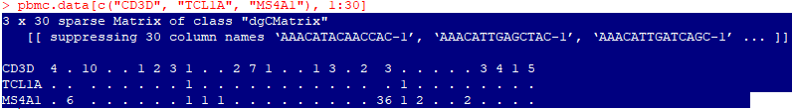
Set up the Seurat object
Interpretation of the output
The “.” values in the matrix represent 0s(no molecules detected).
Most values in an scRNA-seq matrix are 0, Seurat uses a sparse-matrix representation whenever possible.
Significant memory and speed is saved for Drop-seq/inDrop/10x data.

Slide 10
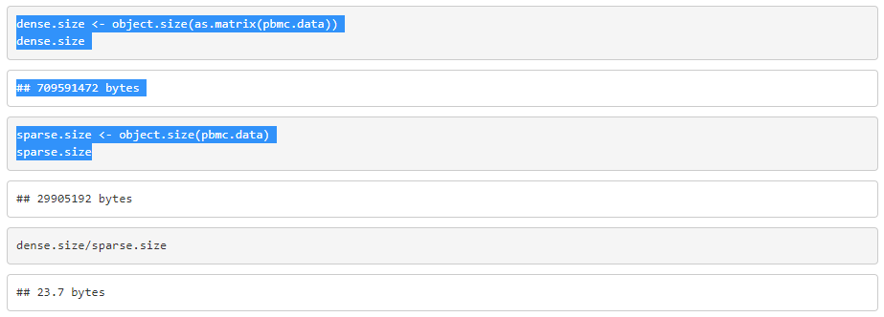
Set up the Seurat object

Slide 11
QC and selecting cells for further analysis
The number of unique genes detected in each cell.
Low-quality cells or empty droplets will often have very few genes
Cell doublets or multiplets may exhibit an aberrantly high gene count
Similarly, the total number of molecules detected within a cell (correlates strongly with unique genes)
The percentage of reads that map to the mitochondrial genome
Low-quality / dying cells often exhibit extensive mitochondrial contamination
We calculate mitochondrial QC metrics with the PercentageFeatureSet function, which calculates the percentage of counts originating from a set of features
We use the set of all genes starting with MT- as a set of mitochondrial genes

Slide 12
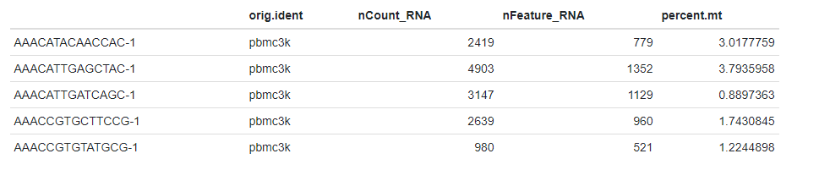
QC and selecting cells for further analysis
The number of unique genes and total molecules are automatically calculated during CreateSeuratObject
You can find them stored in the object meta data

Slide 13
Visualize QC metrics
#A Violin Plot is used to visualise the distribution of the data and its probability density.This is done to view the QC metrics
We filter cells that have unique feature counts over 2,500 or less than 200
We filter cells that have >5% mitochondrial counts

Slide 14
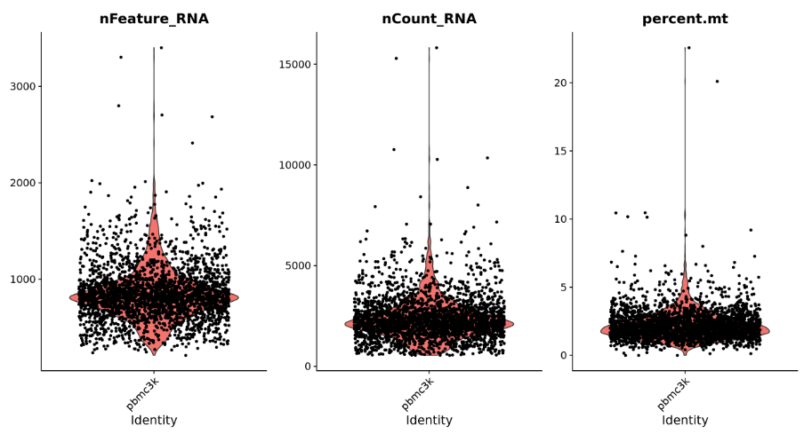
Visualize QC metrics

Slide 15
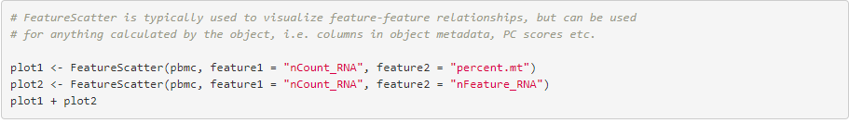
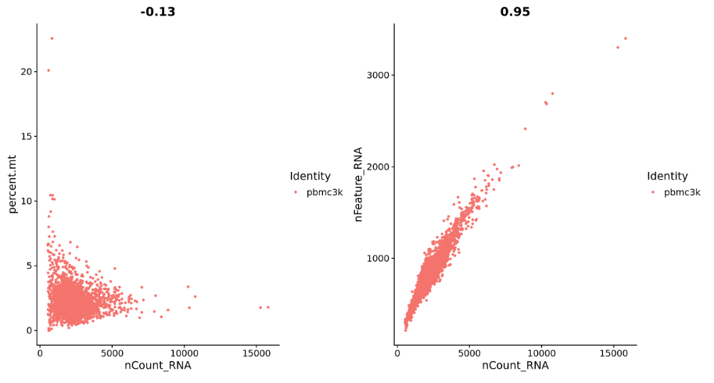
Visualize QC metrics
Subset is a function to filter the unwanted cells in the dataset.
This function calculates the features that exhibit high cell-to cell variation in the dataset.
some cells have highly expressed genes and some has lowly expressed gene

Slide 16
Normalize the data
Normalize the data .
Usually LogNormalize is used.
This normalizes the feature expression measurements for each cell by the total expression,
Multiplies this by a scale factor (10,000 by default),
Log-transforms the result (satijalab).

Slide 17
Identify Variable Feature Selection
###################################################################
Identify features that are outliers on a 'mean variability plot'.
We use the vst selection method .
vst: First, fits a line to the relationship of log(variance) and log(mean)
Using local polynomial regression (loess). Then standardizes the feature values
Using the observed mean and expected variance (given by the fitted line).
Feature variance is then calculated on the standardized values after
Clipping to a maximum (see clip.max parameter - default value is auto).
Other methods are mean.var.plot(mvp)-identofy variable features while controlling
The strong relationship between variability and average expression,
dispersion(disp)- select genes with highest dispersion values.
###################################################################

Slide 18
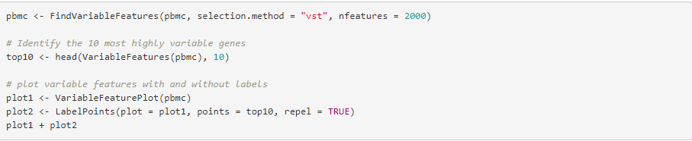
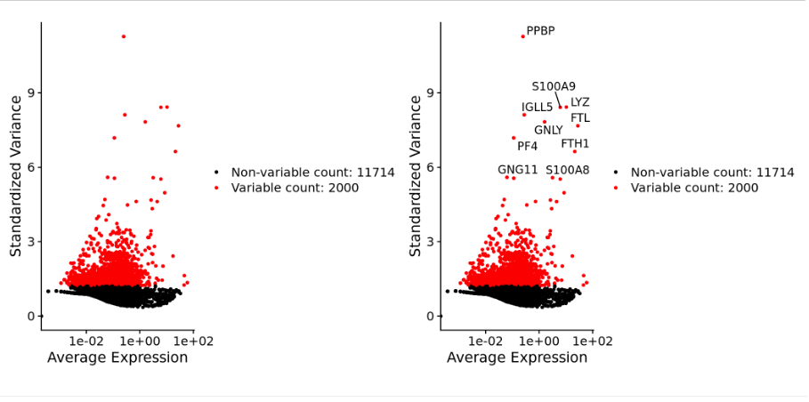
Identify Variable Feature Selection

Slide 19
Scaling the data
Next, we apply a linear transformation (scaling ) that is a standard pre-processing step prior to
dimensional reduction techniques like PCA.
The ScaleData function:
Shifts the expression of each gene, so that the mean expression across cells is 0
Scales the expression of each gene, so that the variance across cells is 1
This step gives equal weight in downstream analyses, so that highly-expressed genes do not dominate
The results of this are stored in pbmc[["RNA"]]@scale.data

Slide 20
Perform Linear Dimensional Reduction
Through this line of code the PCA and clustering (analysis methods) results will be unaffected.
The heatmaps (DoHeatmap function) will require genes for it to be scaled.
After that we will perform PCA on the scaled data.
The previously determined variable features are usually used as an input
Through the use of the features argument you can choose another subset.

Slide 21
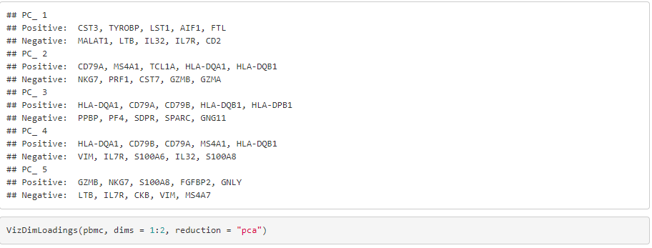
Perform Linear Dimensional Reduction

Slide 22
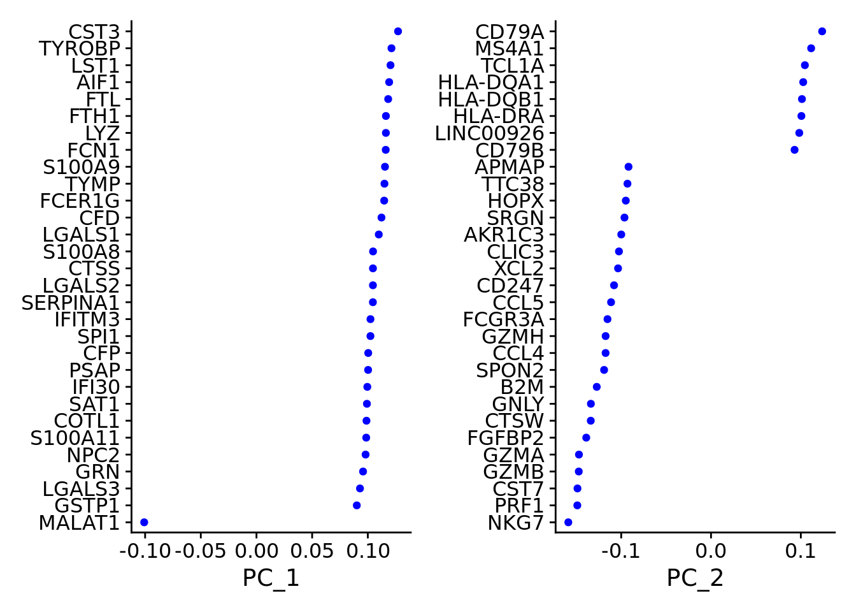
Perform Linear Dimensional Reduction

Slide 23
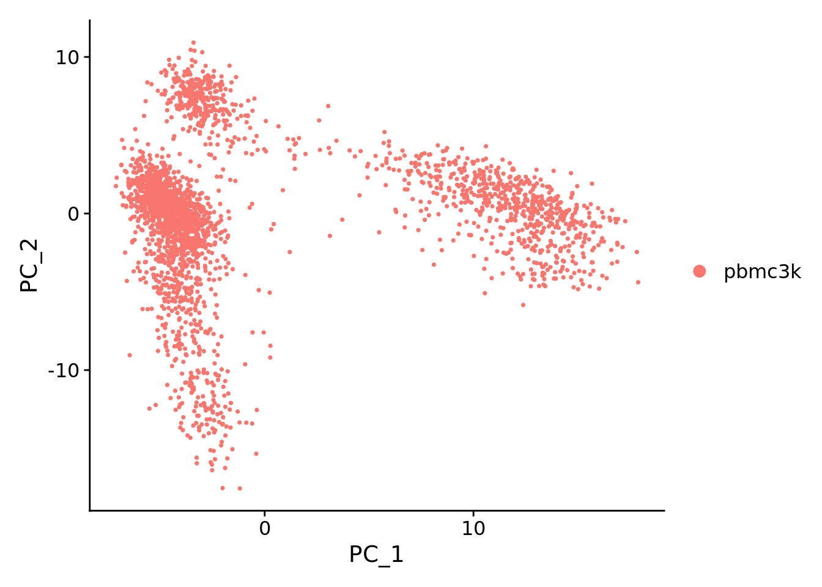
Perform Linear Dimensional Reduction

Slide 24
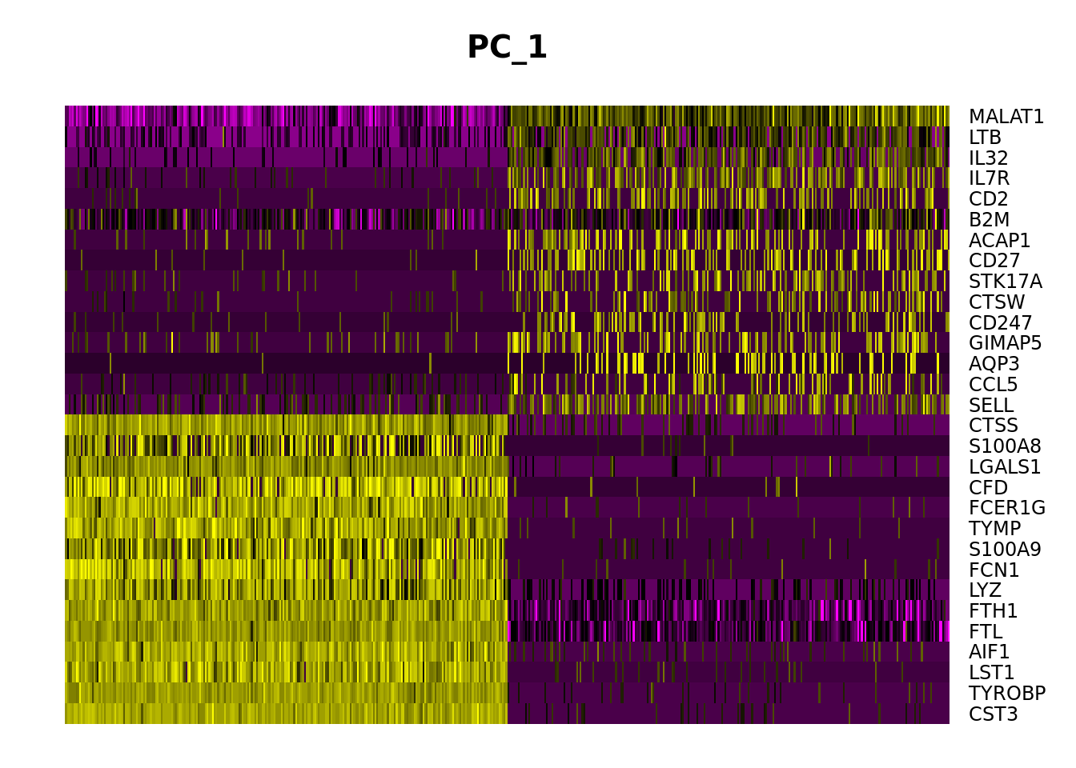
Perform Linear Dimensional Reduction
Draws a heatmap focusing on a principal component.
Both cells and genes are sorted by their principal component scores.
Allows for nice visualization of sources of heterogeneity in the dataset.

Slide 25
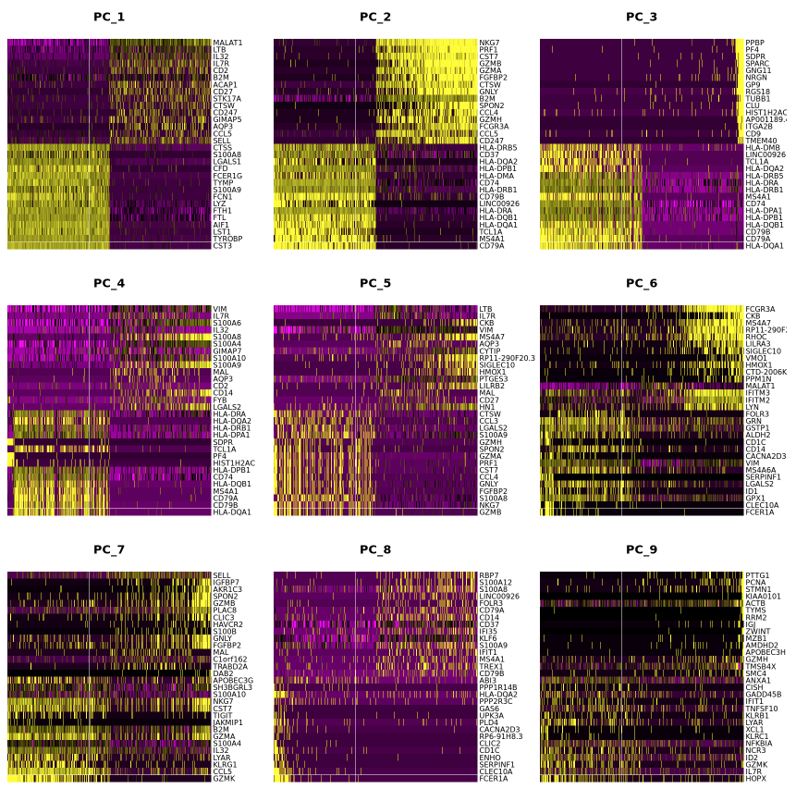
Perform Linear Dimensional Reduction

Slide 26
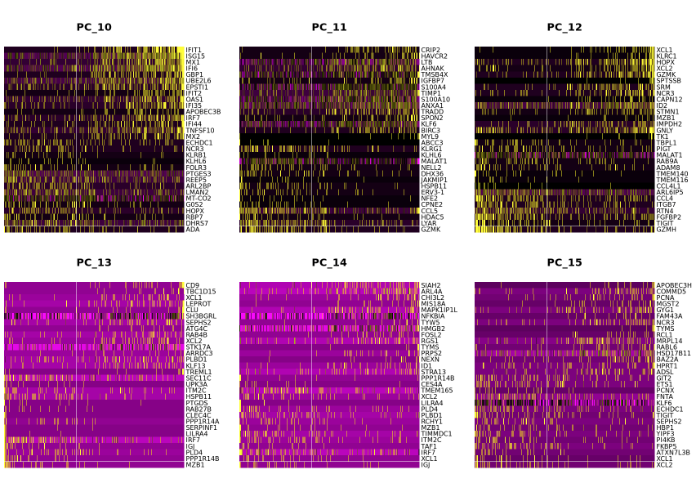
Perform Linear Dimensional Reduction

Slide 27
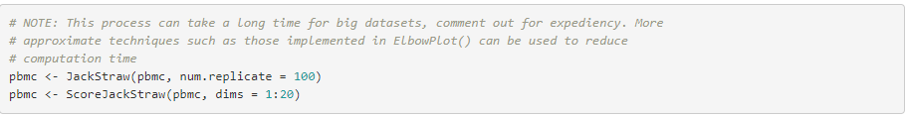
Determine the Dimensionality of the Dataset
Determine Statistical Significance of PCA Scores.
Randomly permutes a subset of data, and calculates projected
PCA scores for these 'random' genes.
Then compares the PCA scores for the 'random' genes with the observed PCA scores to determine statistical signifance.
End result is a p-value for each gene's association with each principal component.

Slide 28
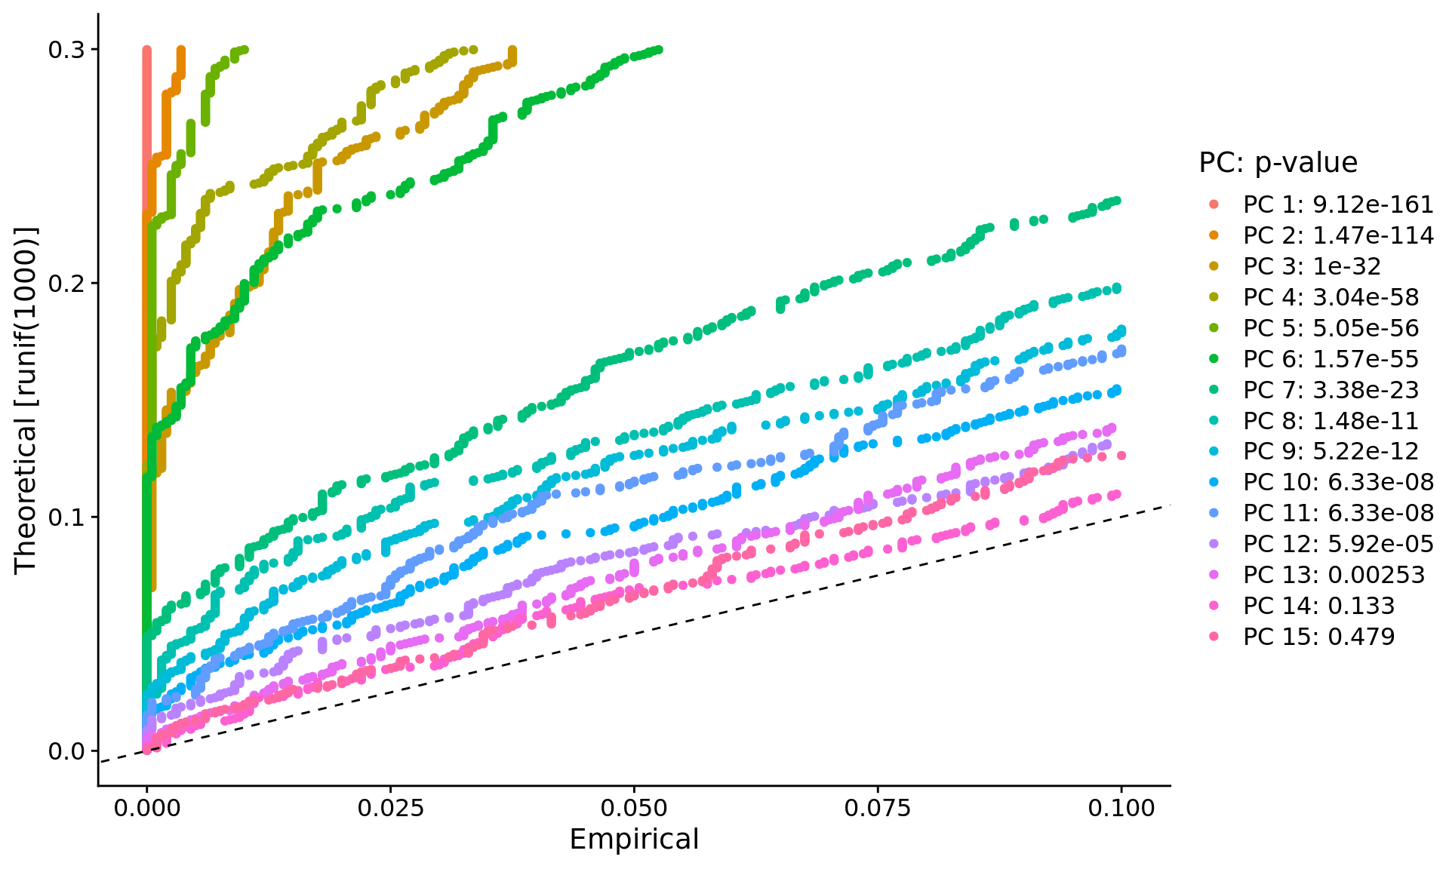
Determine the Dimensionality of the Dataset

Slide 29
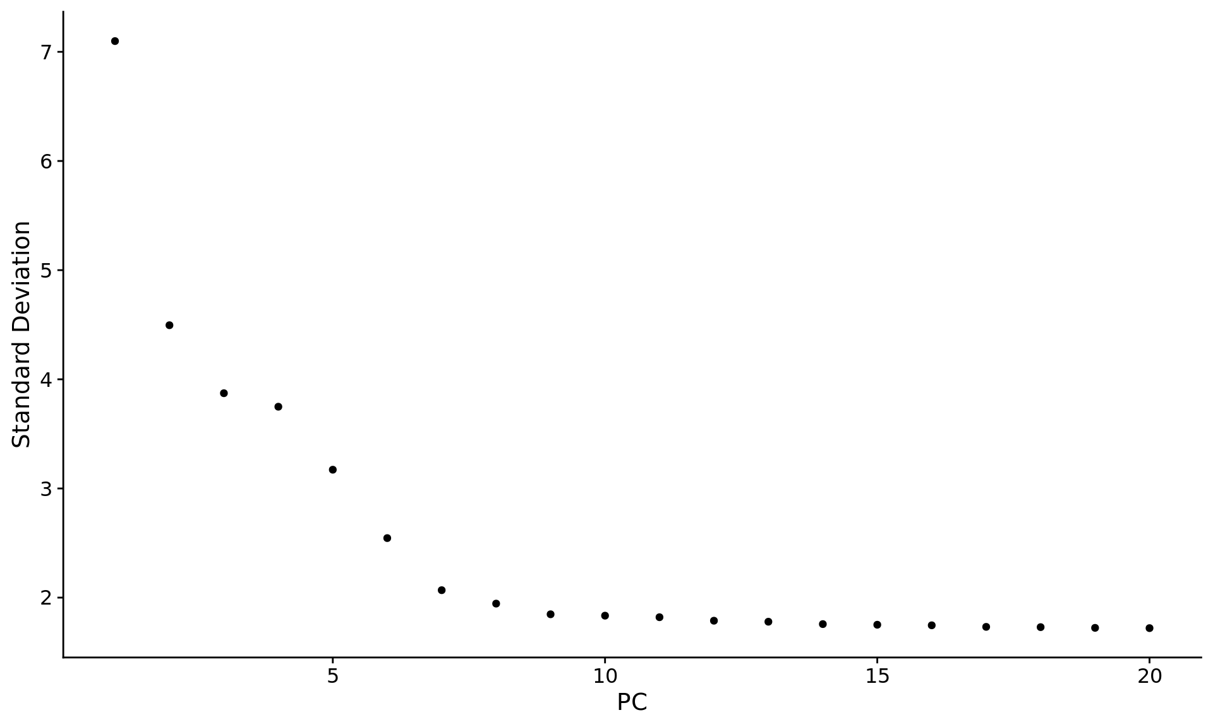
Determine the Dimensionality of the Dataset
Elbow Method for finding the optimal number of clusters
This method is based on the percentage of variance.

Slide 30
Cluster the cells
Constructs a Shared Nearest Neighbor (SNN) Graph for a given dataset.
We first determine the k-nearest neighbors of each cell.
We use this knn graph to construct the SNN graph by calculating
the neighborhood overlap (Jaccard index) between every cell
and its k.param nearest neighbors.

Slide 31
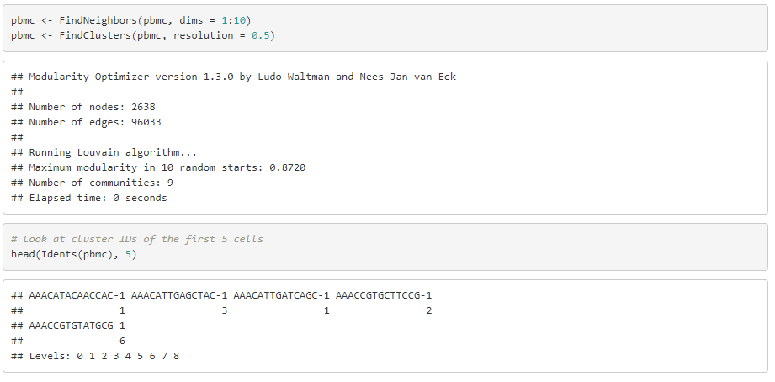
Cluster the cells

Slide 32
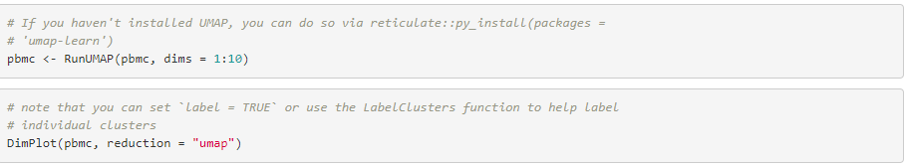
Run non-linear Dimensional Reduction
UMAP - A non Linear Technique to explore dataset
Runs the Uniform Manifold Approximation and Projection (UMAP) dimensional reduction technique.
To run, you must first install the umap-learn python package (e.g. via pip install umap-learn).
Details on this package can be found here: https://github.com/lmcinnes/umap.

Slide 33
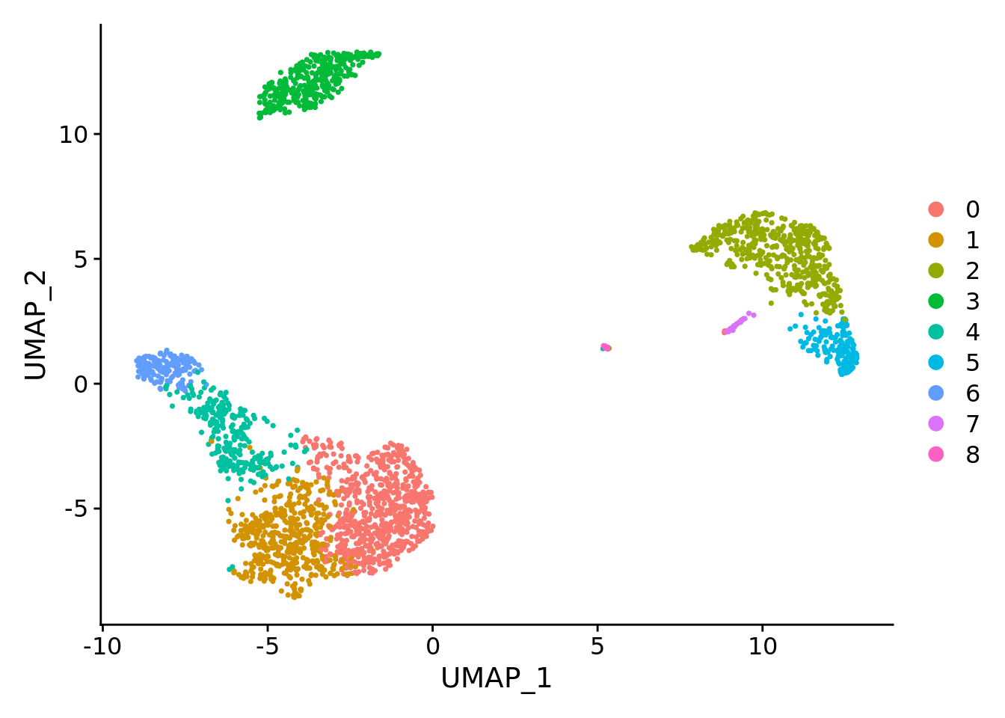
Run non-linear Dimensional Reduction
Save the object to make it easy to load it back

Slide 34
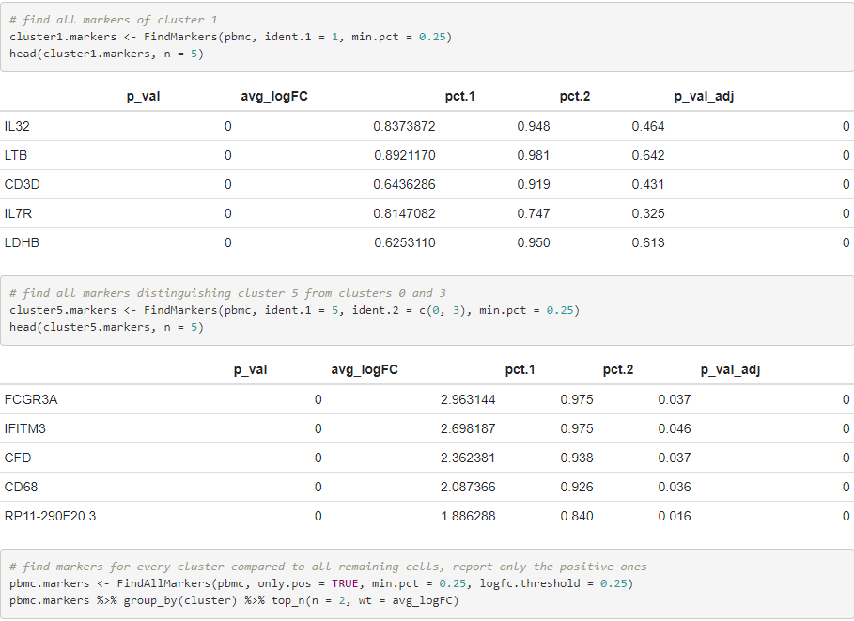
Find Differentially expressed features- (Cluster biomarkers)

Slide 35
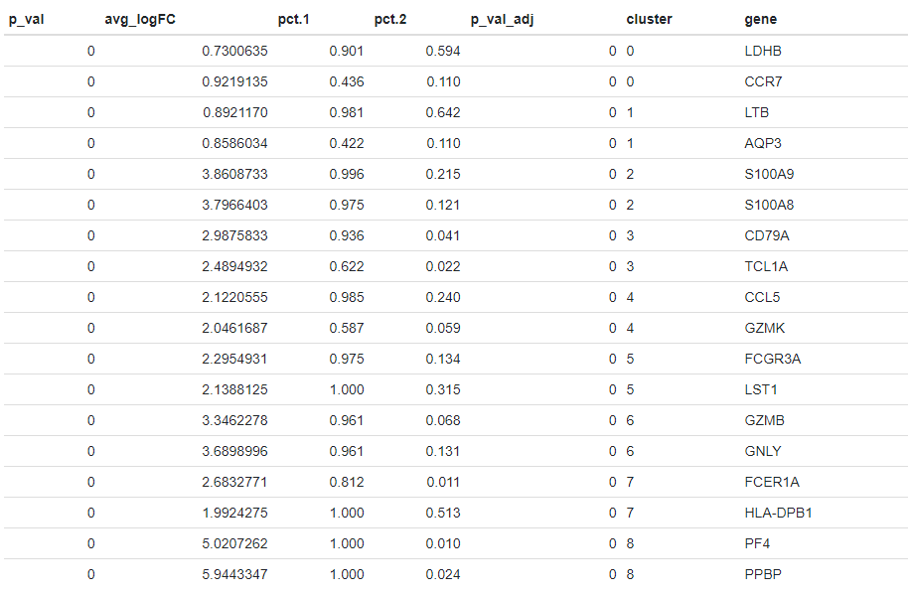
Find Differentially expressed features- (Cluster biomarkers)

Slide 36
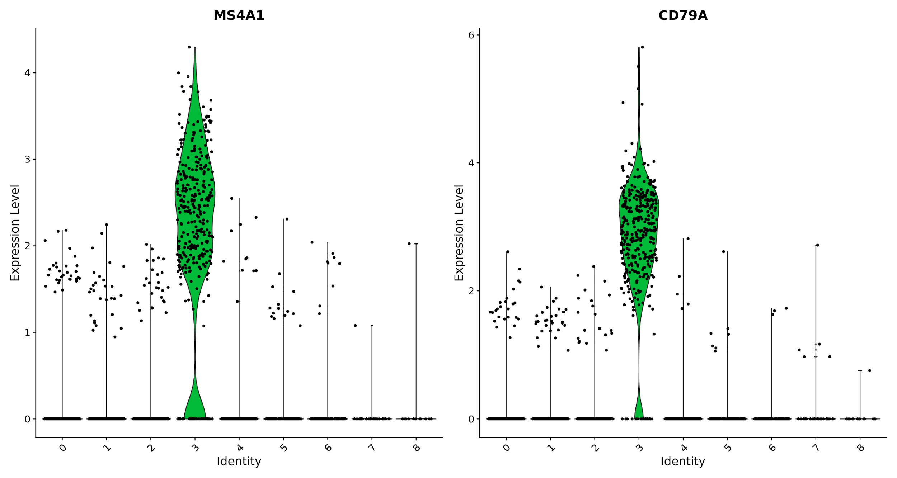
Find Differentially expressed features- (Cluster biomarkers)
Finds markers for every cluster compared to all remaining cells, report only the positive ones

Slide 37
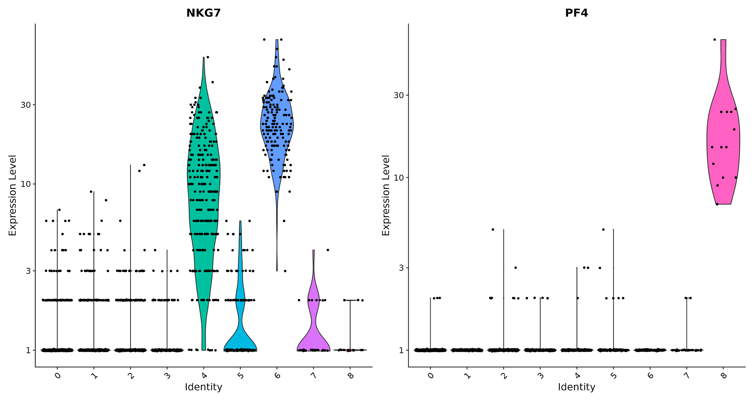
Find Differentially expressed features- (Cluster biomarkers)
Finds markers for every cluster compared to all remaining cells, report only the positive ones

Slide 38
Find Differentially expressed features- (Cluster biomarkers)
The FeaturePlot function visualizes feature expression on a tSNE or PCA plot.

Slide 39
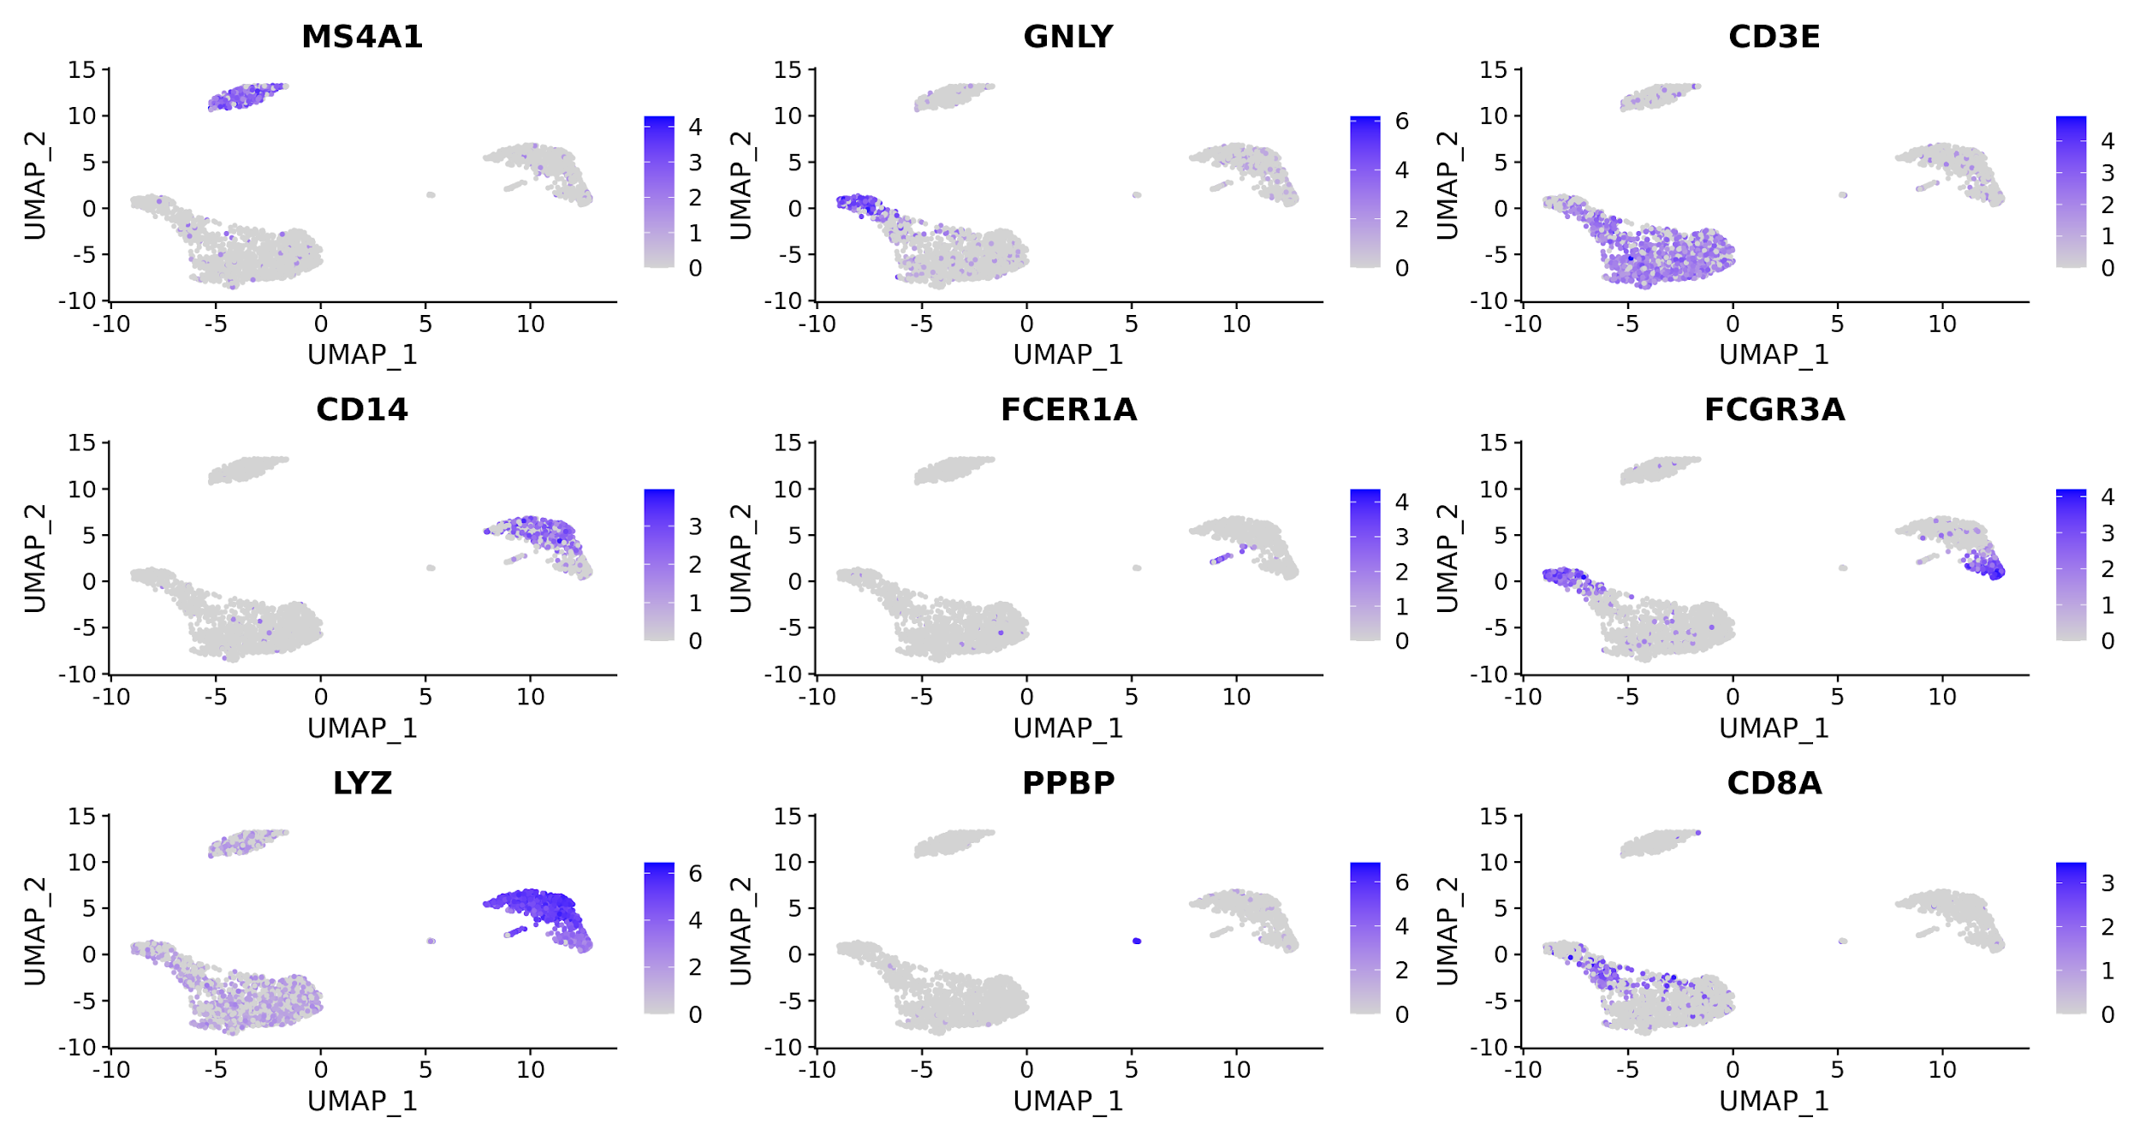
Find Differentially expressed features- (Cluster biomarkers)
The FeaturePlot function visualizes feature expression on a tSNE or PCA plot.

Slide 40
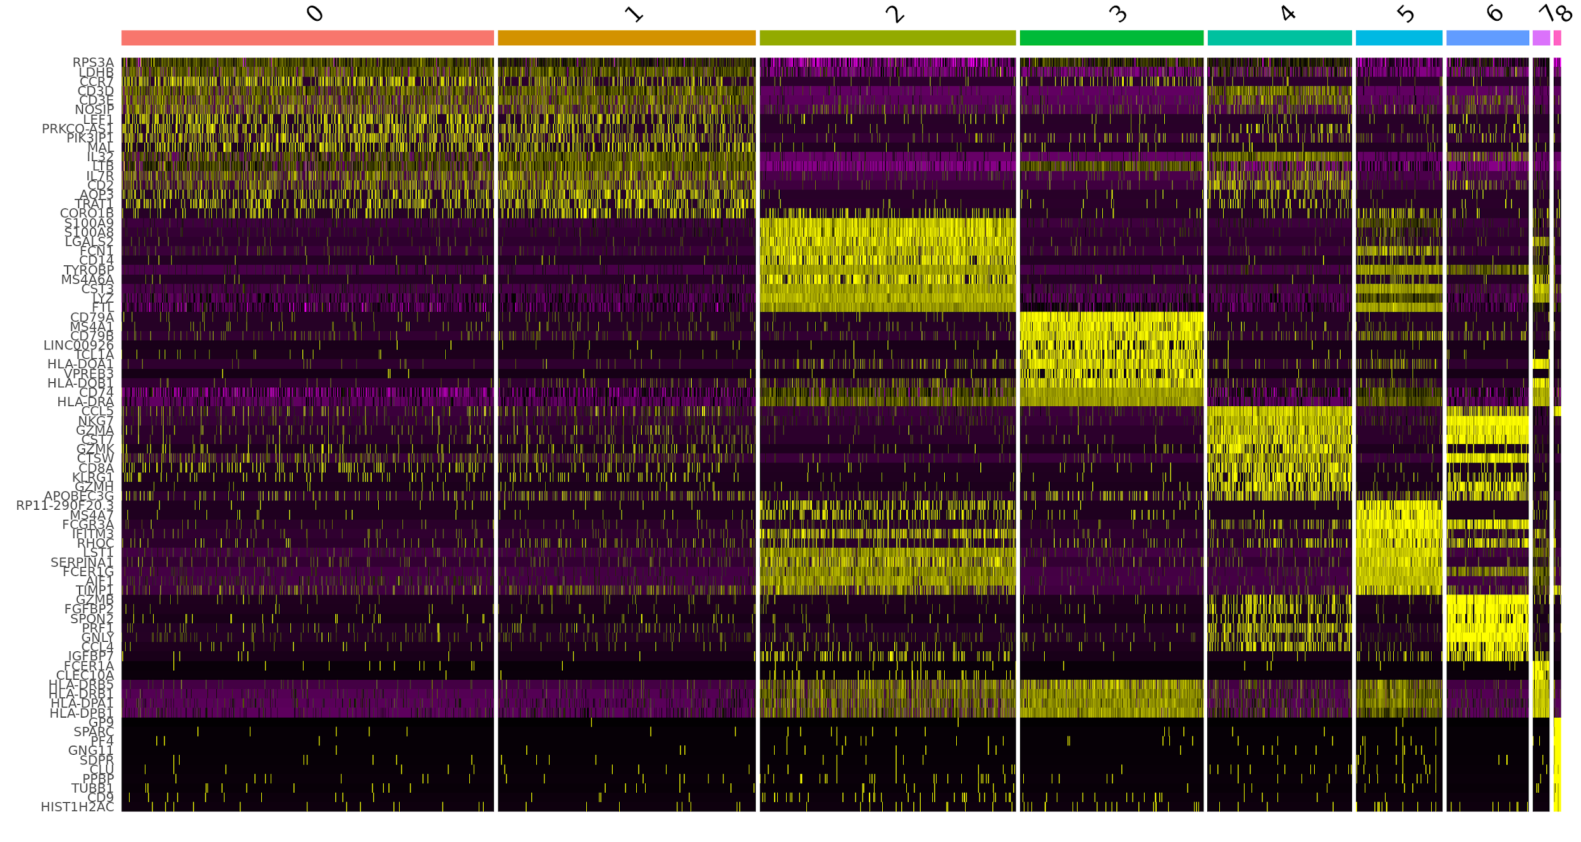
Find Differentially expressed features- (Cluster biomarkers)
The DoHeatMap creates a heatmap for the given cells and features.

Slide 41
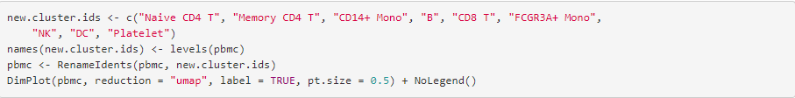
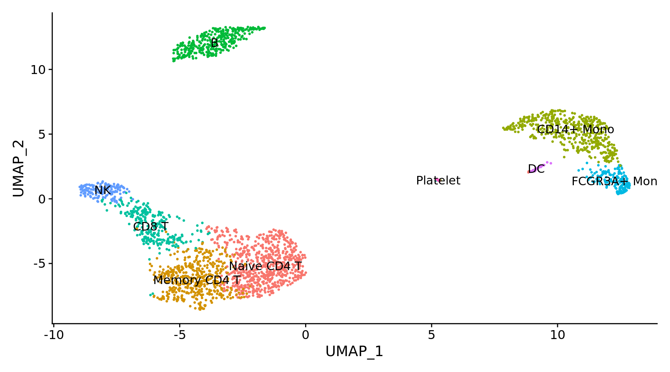
Assign cell type identity to clusters.

